Slide 1
AMASE Tutorial Session
AMASE
a simulation for autonomy research
Updated 20 Feb 2014 by Matt Duquette (AFRL/RQQD)

Slide 2
Agenda
Introduce AMASE
Discuss AMASE data flow and LMCP
Interactively build and execute a scenario
Review the AMASE distribution folder
Touch on AMASE architecture and code
This session is meant to be interactive. Please ask Questions

Slide 3
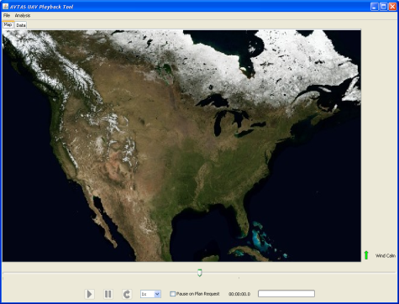
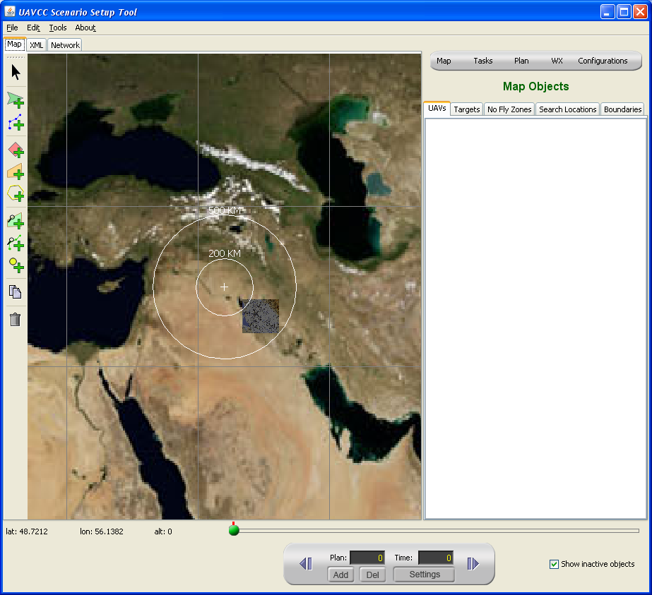
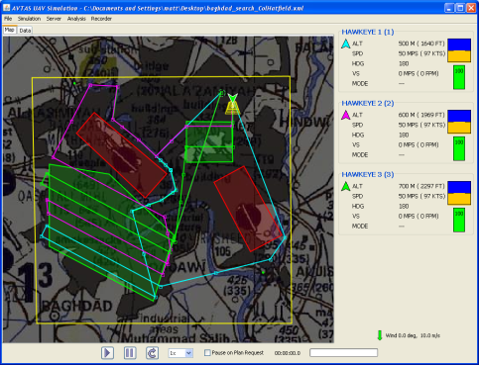



AMASE
a simulation for autonomy research
The AVTAS Multi-Agent Simulation Environment provides a single desktop-based toolset for UAS autonomy research.
Create UAS scenarios
Define Vehicle Capabilities
Connect external applications to provide UAV commands
Collect, present, and analyze UAV mission performance
AMASE
Clients
C++
A common interface connects autonomous control systems from industry, academia, and government.
C#
Develop
Test
Analyze
One Toolset closes the loop between cooperative control development and analysis/demonstration.
Notes:
Main Points:
- Collaboration through Simulation: The purpose of AMASE is to supply an easy-to-run, easy-to-connect-to simulation for both in-house use and outside organizations.
Minimize re-work and learning curves: The interface allows native development by the many algorithm suppliers (industry, academia, government) The interface supports all popular programming languages, computing platforms
Improve Speed of Development: AMASE has shown to tighten the develop-Test-Analyze loop. Quick looks as well as advanced development are both possible with AMASE.
True government ownership of government funded products: By providing a common platform and interface, software developed by other organizations is executable in-house, and reusable for other projects.

Slide 4

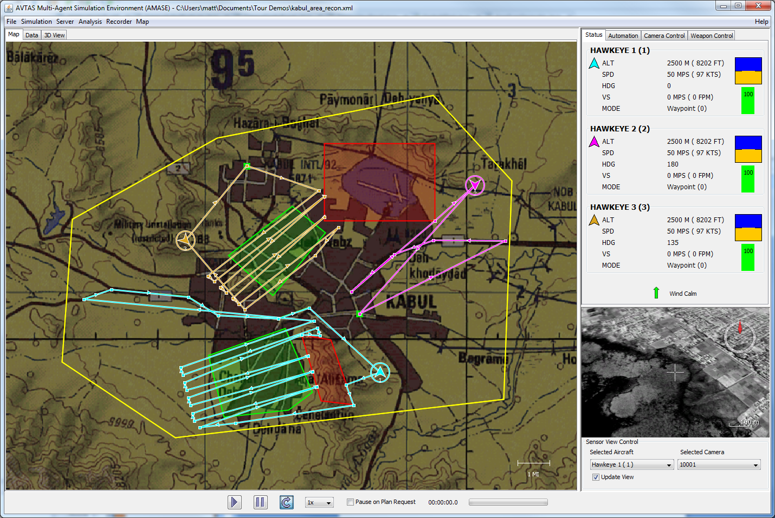

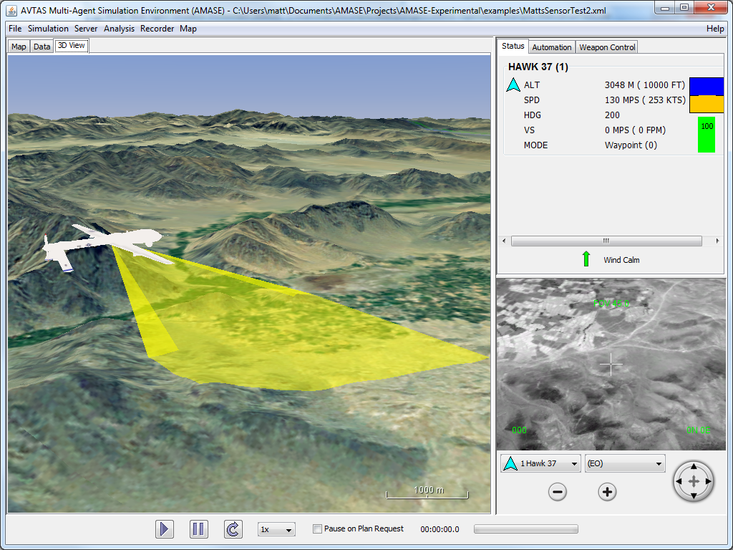
The Facets of AMASE
AMASE is an Application
Tool to simulate multi-UAS missions
Setup, run, and review scenarios
Connect external applications via a network interface
Approved for use by non-DoD users
AMASE is an Application Platform
Create customized AMASE-based applications
Modify/Enhance any component of AMASE
Extend the data interface to include new, custom data
AMASE is a library of tools
Use AMASE functions in your own application
GIS, data management, window management, GUI tools, flight and sensor models, math tools, mission planning, and more…

Slide 5
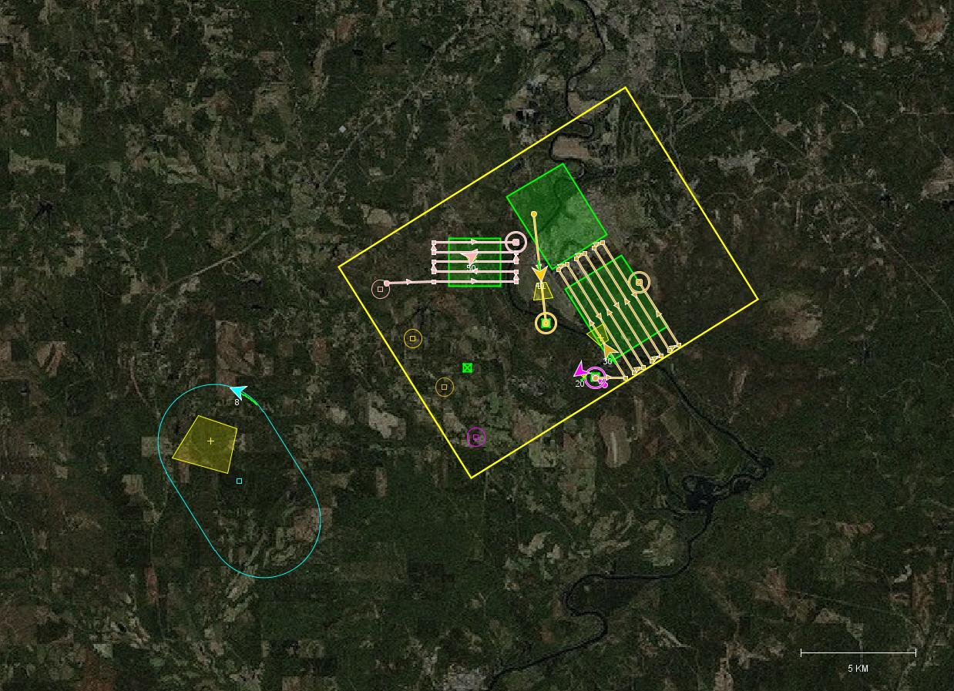
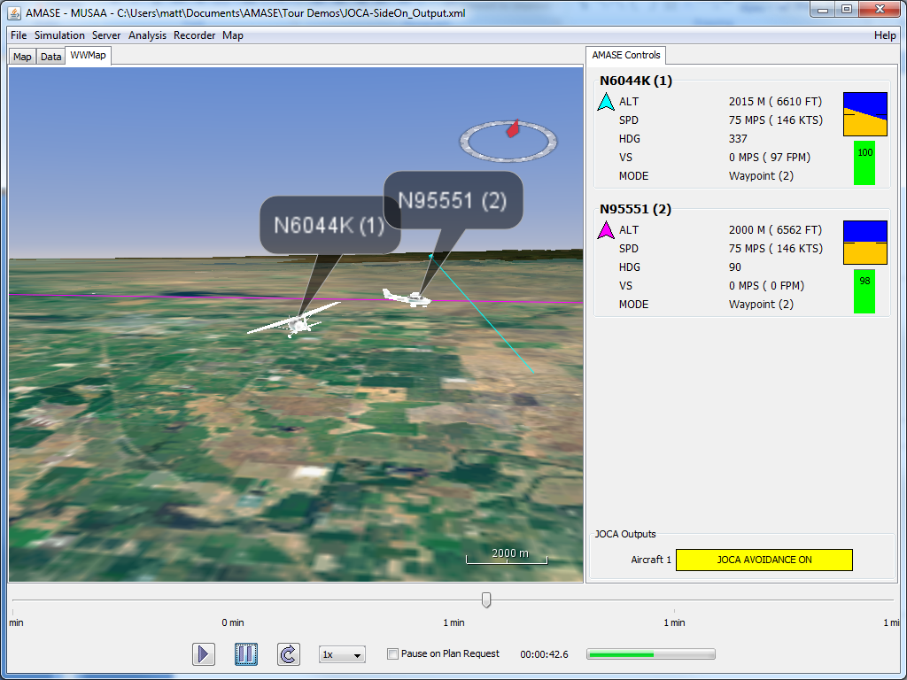
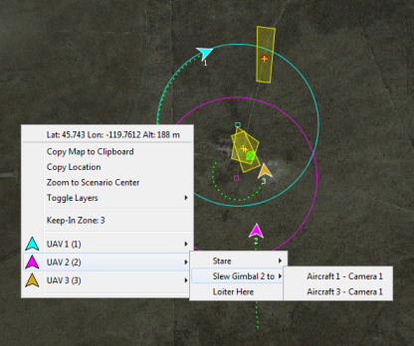
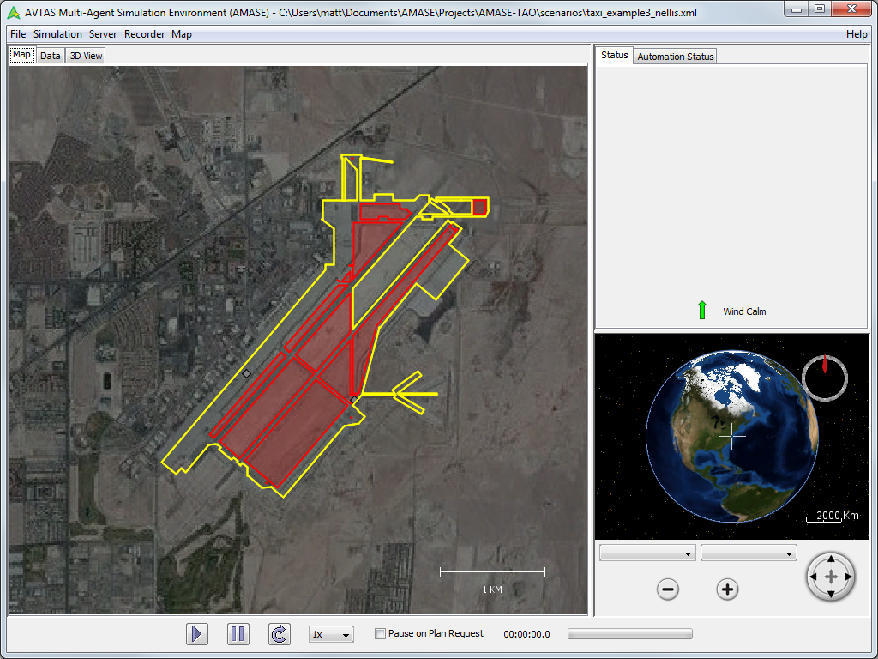
Some Applications of AMASE
Cooperative Control
Sense and Avoid
Advanced Sensor Models
Contracted and In-house Efforts
Rapid Prototyping and Demonstration of Techniques
Demonstration and Testing of Avoidance Algorithms
Operations in the Terminal Area
Analysis of unmanned aircraft autonomy in and around airports
Integration of autonomous and piloted simulation
Flight test interfaces
Exploration of man-machine interfaces
Basic and applied research special topics
Advanced Autonomy and Human Interaction
Notes:
AMASE was born as a cooperative control simulation, but has been adapted and expanded into other areas. AMASE is well suited for any project that involves multiple entities interacting in a common environment.
Sense and Avoid is the latest research area to adopt AMASE. Advanced sensor modeling and integration of avoidance algorithms have been integrated into the AMASE framework. By using existing AMASE components, contractors and in-house personnel have been able to focus on the SAA-related problems, rather than building separate simulations.

Slide 6
AMASE Modeling Features
Navigation Modeling
Loitering and autopilot control
Parametric Flight Models
Cruise, Climb, Loiter, Descent modes
Used to model very small to large UAVs
EO/IR Sensor Modeling
Quaternion-based sensor frustum calculations
Time limited Johnsons criteria for target identification
Target Movement and Tracking
Declare targets and script movement
Track targets with UAVs
Waypoint Following
Notes:
- Any one feature of AMASE doesn’t make AMASE unique, but the synergy of the features makes AMASE the only self-contained UAV teaming simulation of its kind.
Navigational capabilities represent a combination of real-world aircraft capabilities: loiter, waypoint following, basic autopilot commands
Parametric flight modeling enables stable flight, using a minimum amount of configuration data. Has been used to represent very small to very large UAVs
Sensor modeling (mostly EO/IR) includes a high-fidelity representation of view frustum, moving gimbals, geographic point-stare, and a simple operator model for target detection
Target movement enables more advanced scenarios using scripted movement, or movement controlled by internal/external plugins.
Target tracking capability is include so UAVs can acquire and follow moving targets, or automatically loiter around stationary targets.

Slide 7
AMASE Extensibility
LMCP and CMASI Data Interface
Common data exchange language for UAV operations
Developed in-house and used by multiple organizations
Plug-in architecture
Develop plug-ins to extend capability
Change GUI, modeling, or data handling features
Visualization, mapping, and analysis
Add components within simple, well-defined system
Enhance capability with little additional programming
Easily extensible to many domains
AMASE is a platform - adaptable to ever-changing research goals
Notes:
- The CMASI data architecture and underlying LMCP protocol allow for many types of external tools/algorithms to connect to AMASE
--The LCMP system allows almost limitless customization of data types for custom versions of AMASE
- Plugins extend AMASE capability. The internal models can be augmented or replaced entirely through the use of custom plugins.
- The AMASE GUI, data management, analysis system, moving map, and 3D displays are all based on a plugin architecture. Any component can be added/removed.
- Visualization is a strength of AMASE. The 2D/3D visualization allows team-based analysis of mission plans and communicates capabilities quickly.
-- Good visualization is important for rapid development
-- The 2D map display allows developers to easily add layers for additional data visualization
-- Leveraging NASA Worldwind for 3D and sensor viewing brings thousands of man-hours of effort for free.
Big point: AMASE is not a fixed, inflexible simulation. It is open-source, free, and architected for easy expansion by any developer.

Slide 8
The AMASE Community
AMASE follows an open source model
Anyone in the DoD can use the full toolkit
AMASE has participants, not customers
Users
Documenters
Bug Reporters
Developers
Advocators

Slide 9
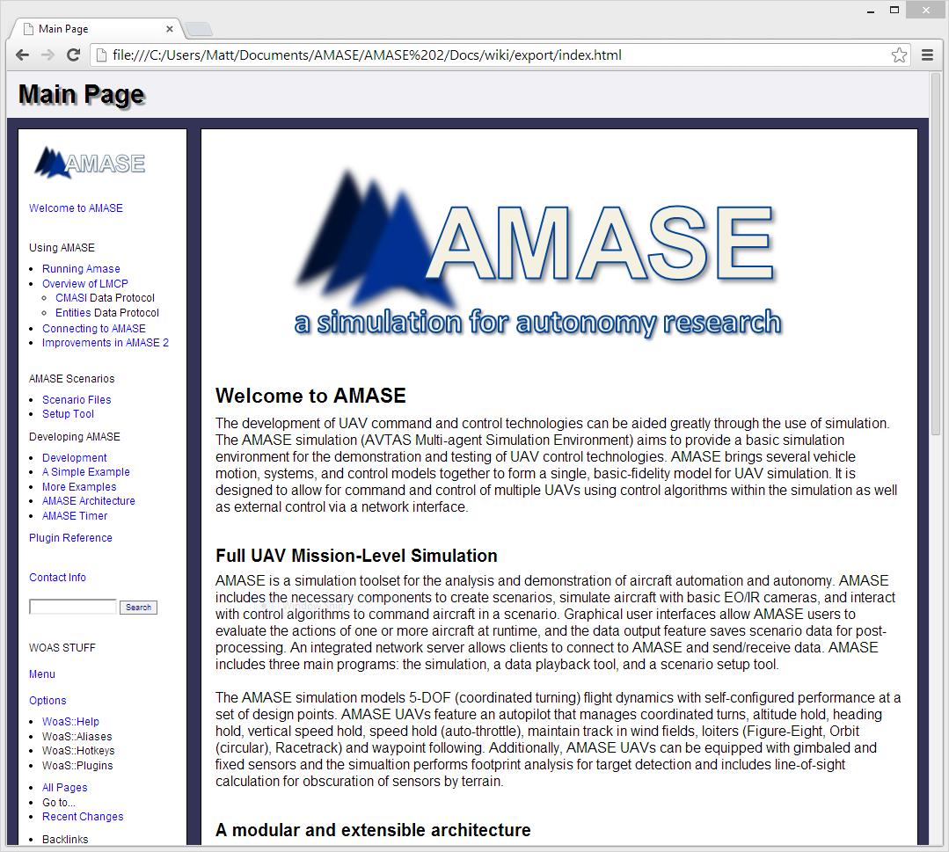
AMASE Wiki
AMASE now features a Wiki-style help system based on wiki-on-a-stick (stickwiki.sourceforge.net)
AMASE is a large, multi-faceted toolkit. Documentation is needed to help the user community
Looking for volunteers to build on wiki documentation
Look in the doc folder of AMASE for the wiki
We need your help documenting AMASE design and use

Slide 10
Warning: Technical Content
To develop on AMASE, you should have:
background in object-oriented programming
Proficiency in the Java programming language
Familiarity with the XML data language
Familiarity with GUI programming in Java
To use AMASE, you should have:
Knowledge of UAS operations
Basic knowledge of flight mechanics, navigation
Time to learn data specifications and develop scenarios

Slide 11
Data Flow in AMASE: Using LMCP and CMASI
When combining plugins within an application, or communicating between applications, a good data specification can enable complex behaviors. AMASE extensively uses an AFRL-developed object-oriented data specification called LMCP.

Slide 12
Data exchange in applications
Application A
Application
B
Data Stored in Files
Plugin
1
Plugin
2
Data exchanged between applications
(Network Data)
Data exchanged between application components

Slide 13
The LMCP Data Interface
Lightweight Message Construction Protocol
Produces Objects that are used in programs (C++, Java, C#, and Python)
Uses an object oriented approach
Inheritance, encapsulation
Allows extensibility
Serializes data to pass between applications

Slide 14
LMCP Data Models
Data Model A
Shape
Data Model B
Data Model C
Rectangle
Polygon
Square
Hexagon
Octagon
Extension mechanism allows LMCP objects to be defined across data models and be used in a natural, objected-oriented way.

Slide 15
Data Exchange Using LMCP
AMASE
AMASE Client
LMCP
XML
Format
Plugin
1
Plugin
2
LMCP Binary Protocol
(Serialized Objects)
LMCP Objects
(instances of classes)

Slide 16
CMASI Data Model
Developed to express:
Unmanned aircraft Capabilities and Payloads
State of aircraft and payload at a given time
Mission tasks
Zones (keep-in and keep-out)
Request/response model for commanding aircraft

Slide 17
Entities Data Model
Created to enhance AMASE capabilities by adding ground targets and tracking
Expresses:
Any additional entity in the scenario
E.g. aircraft, ground vehicles
Target detection and tracking
Simple path following for ground entities

Slide 18
Custom Data Models
Extends capability of any application using LMCP
Can build on existing data models
In AMASE, we have used custom MDMs to:
Model communications networks
Do sense-and-avoid maneuvers
Model SAM threats
Do advanced sensor and automation tasks

Slide 19
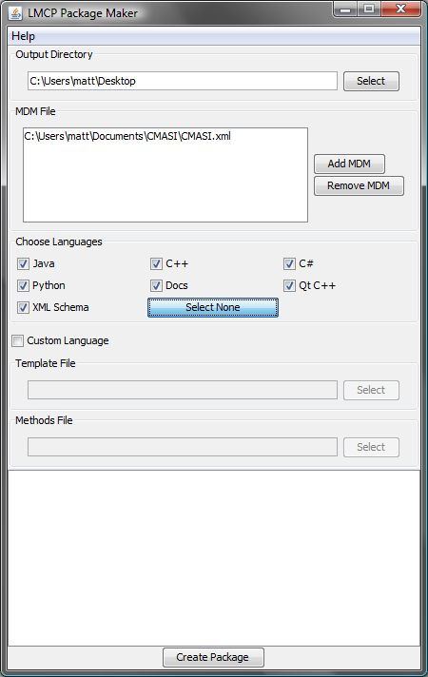
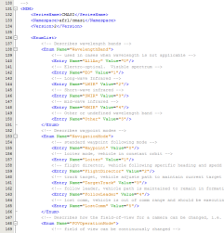
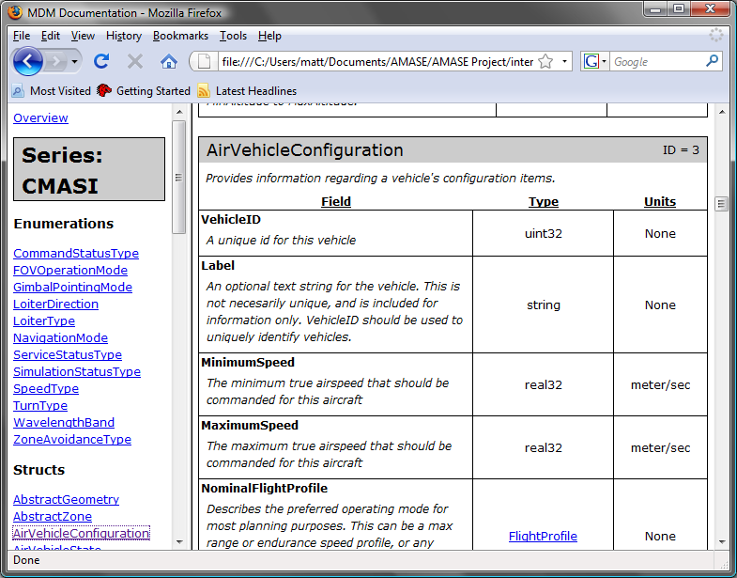
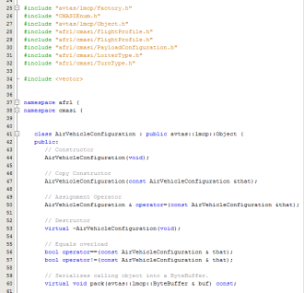
Making LMCP Builds
Data models (MDM) are written in XML-format
LMCP PackageMaker allows quick production of code
Produced code is easy to integrated into applications
Comments written in MDM are automatically included in a browsable HTML-based document
Look in the LMCP/doc folder of the AMASE distribution
<XML/>
HTML Documentation
C++, Java, C#, Python

Slide 20
AMASE Toolset
The baseline version of AMASE. This includes the AMASE simulation, Scenario Setup Tool, and the Playback Tool

Slide 21
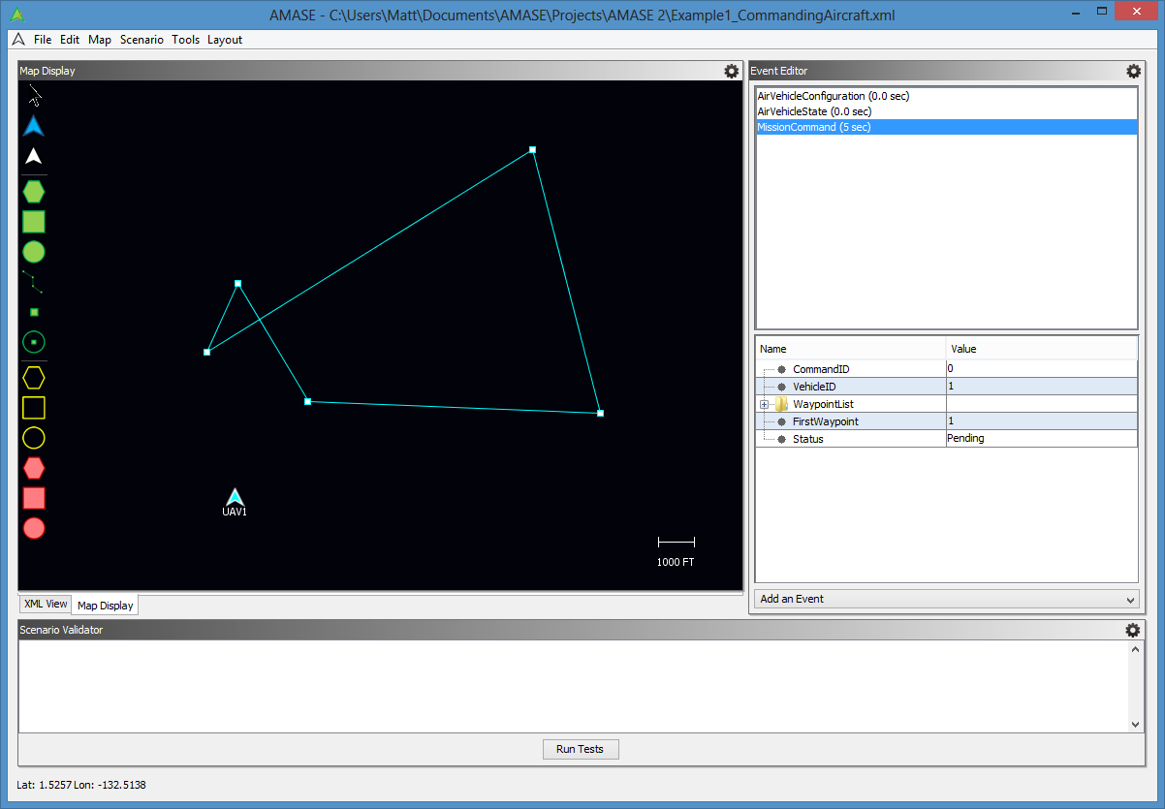
The AMASE Setup Tool
Map
Object
Toolbar
Event
Editor
Scenario
Validator

Slide 22
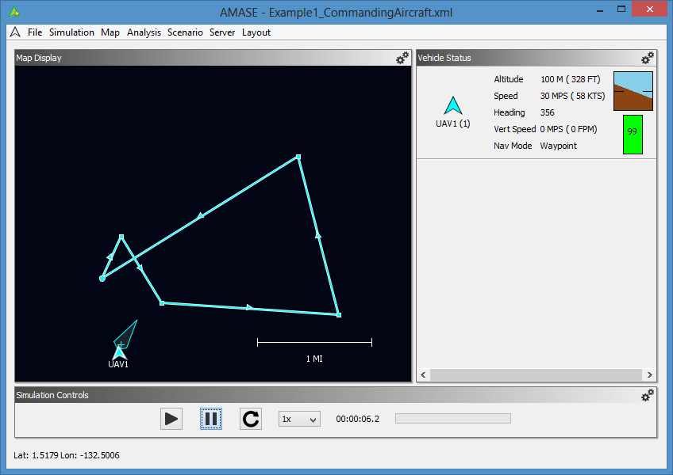
The AMASE Simulation
Map
Status Panel
Simulation Controls

Slide 23
Developing AMASE Applications
AMASE applications build on the AMASE Development Kit (AMASE-DK). The AMASE-DK contains source code and support libraries to build highly complex simulations. Add project specific code to make a specialized AMASE application that builds on all of the pre-existing AMASE capabilities.

Slide 24
AMASE Architecture
AMASE Framework
(Context)
Window Manager
Analysis
Manager
Network Server
Map Plugin
Scenario Manager
Other Plugins
Entity Control
Timer
Scenario
State
Event
Manager
Static
Services

Slide 25
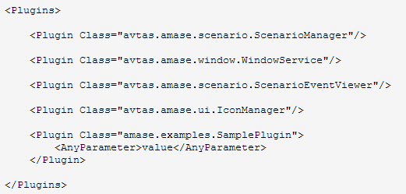
The AMASE Plugin
Step 2 – Add the plugin to the plugins.xml file
Step 1 – Code the plugin
class SamplePlugin extends AmasePlugin {
// see Wiki and Javadoc for things
// you can do with an AMASE plugin
// handle events
eventOccurred(Object event)
// present a GUI
getGui()
}
Filename: config/custom/Plugins.xml
Step 3 – Run your custom AMASE build
java -cp dist/* avtas.app.Application --config config/custom

Slide 26
Exploring the AMASE DK
The source for the entire development kit is available.
Load the Netbeans project and begin exploring
All plugins are loaded through the Plugins.xml file in the config folder
The Examples included help introduce the user/developer through AMASE features

Slide 27
Creating a Custom AMASE App

Slide 28
Creating a Custom AMASE App
Custom AMASE applications are based on the AMASE DK.
The following example uses Netbeans to show how a custom application is built
In this example, a simple data reader is built in Java, and added to the AMASE configuration file as a plugin

Slide 29
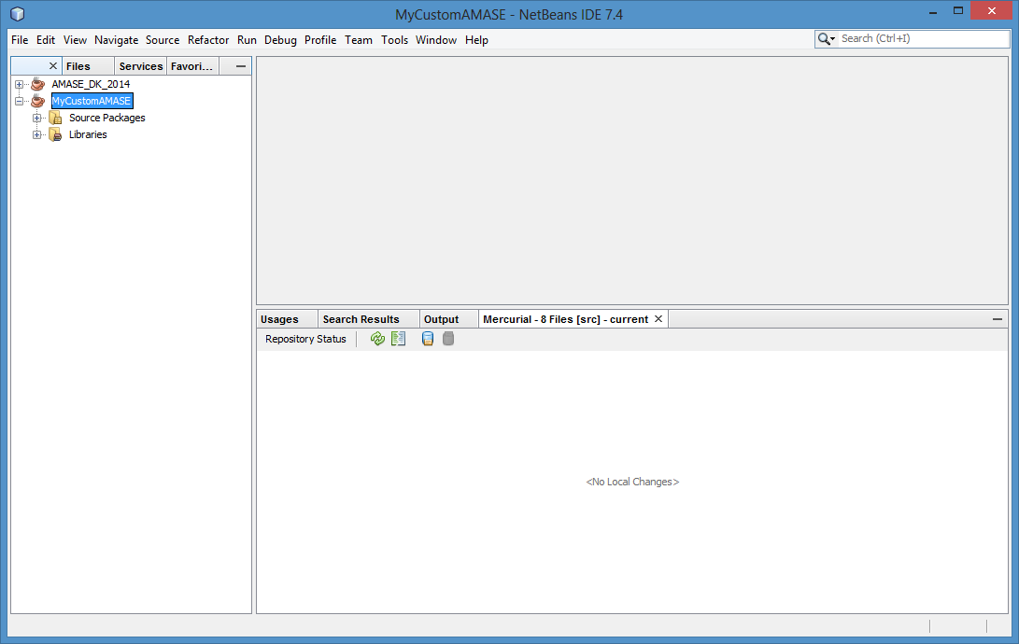
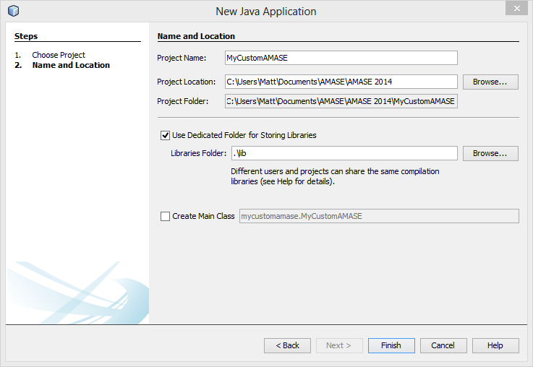
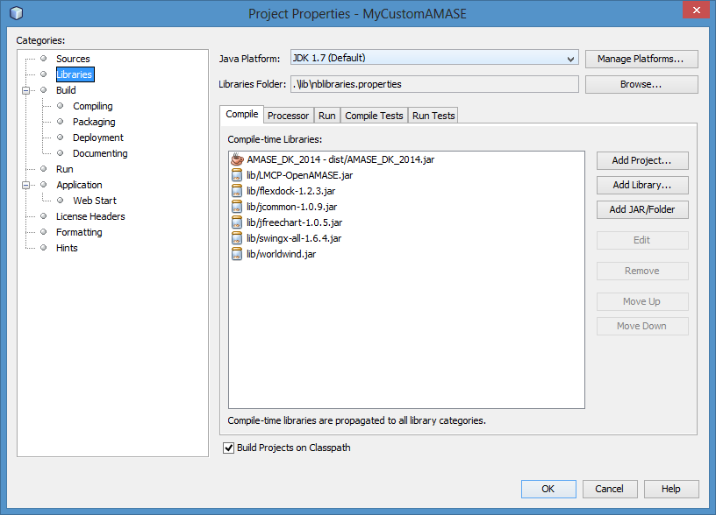
Setup a new Netbeans Project
Open The AMASE-DK in Netbeans
Create a new Netbeans project (in this case it is called MyCustomAMASE)
Add the AMASE-DK as a required project in the “Libraries” section of the new project’s properties dialog.
Also copy all of the jar files that are under the “lib” folder of the AMASE-DK
If you are also using Worldwind components, copy the “jogl” library from “lib” to your new project.

Slide 30
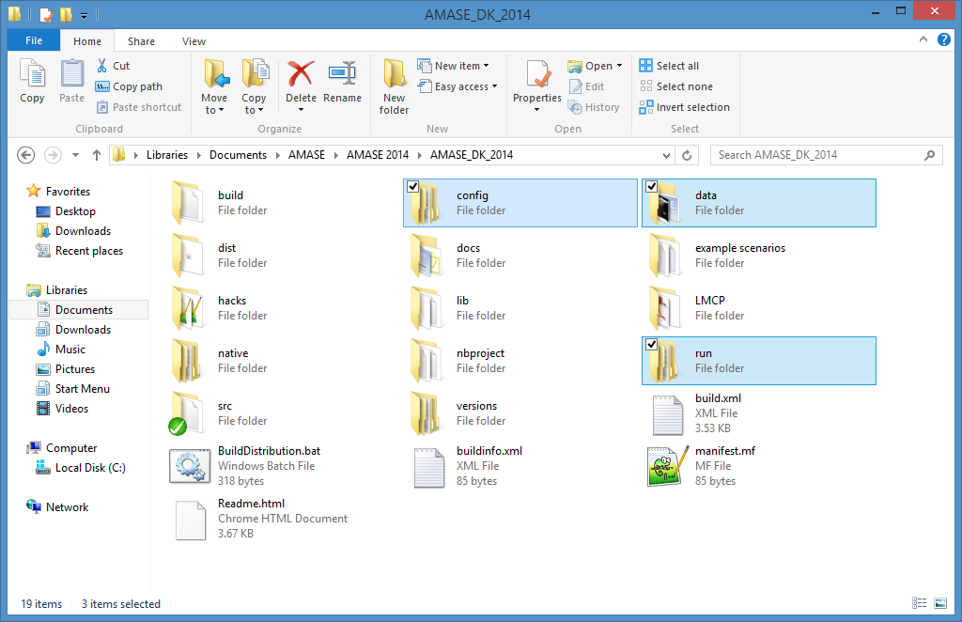
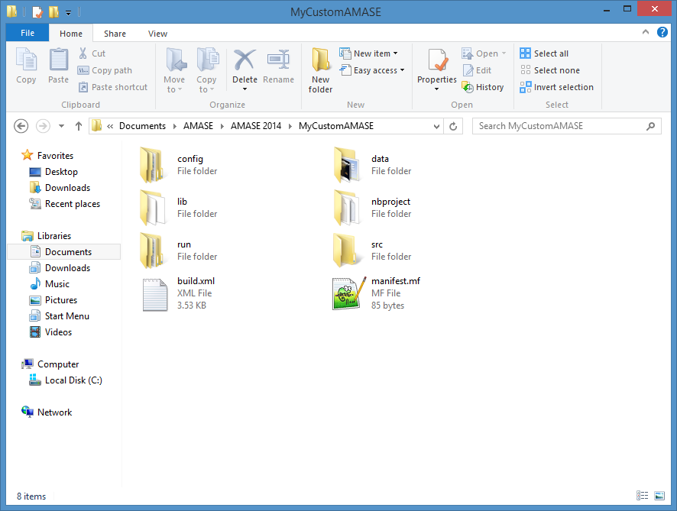
Copy Required Config and Data
Copy the config, run, and data folders from the AMASE-DK to your new project. These will be used as a basis for your new application.

Slide 31
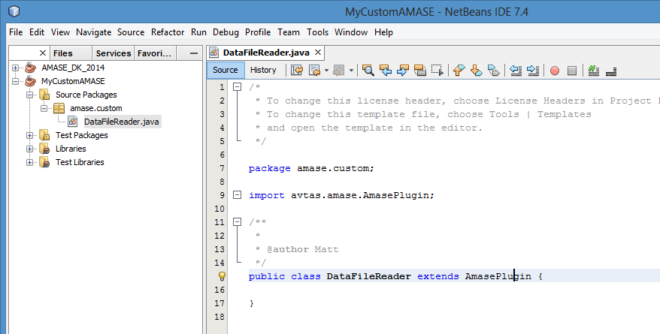
Create your Custom Plugin
The external file reader is created under the java package amase.custom and is called DataFileReader.java
The file reader extends the AmasePlugin class

Slide 32
Add useful code
The data file reader has to prompt the user to open the file, read the file in, and then publish the data to the rest of AMASE for viewing/manipulation.
This is done by creating Entities for every entry in the file.
An EntityConfiguration and EntityState is created for every entry in the file.
The user is presented a menu item from which he/she can select the file to open.
This is the example plugin. If you are viewing this in Powerpoint, open the document

Slide 33
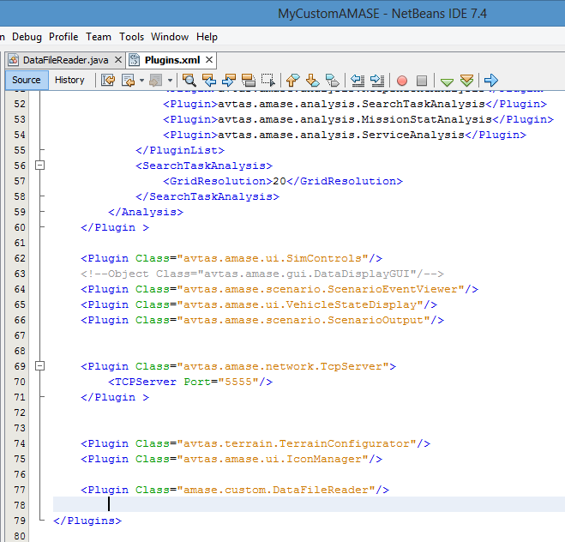
Add the new plugin to the AMASE configuration
Open the Plugins.xml file in the config/amase directory
Add an entry for your new plugin

Slide 34
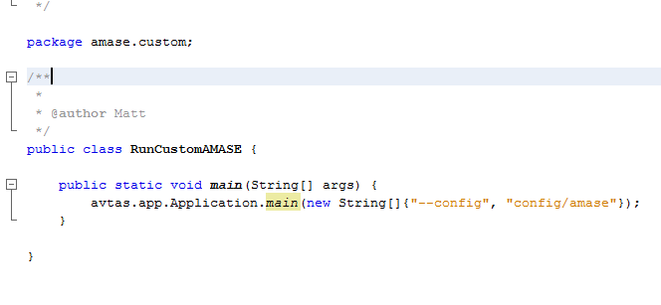
Build and run the project
Build the project by right clicking on the project in Netbeans and selecting “build”
Run the project using the OpenAMASE batch file in the “run/win” or “run/linux” folder.
Note: You can run projects in Netbeans by creating a small class with a main method that runs the AMASE executable file “avtas.app.Application” (example below)
In Netbeans, right click on the project, choose “Run” and select the class that runs your AMASE configuration.

